Slide 1

Noida Institute of Engineering and Technology, Greater Noida
Working capital management,
Unit: IV
Subject Name:
Finance for Engineers
(AOE0770)
Amit Kumar
Assistant Professor
Department: School of Management
Course Details (MTech Int-VIII Sem)

Slide 2
Index/Content
S. No. | Index
1. | Name of Subject with code, Course and Subject Teacher
2. | Brief Introduction of Faculty member with Photograph
3. | Evaluation Scheme
4. | Syllabus
5. | Branch wise Application
6. | Course Objective(s)
7. | Course Outcome(s)
8. | Program Outcomes (POs)
9. | Cos and POs Mapping

Slide 3
Index/Content
S. No. | Index
10. | Program Specific Outcomes (PSOs)
11. | Cos and PSOs Mapping
12. | Program Educational Objectives (PEOs)
13. | Result Analysis
14. | End Semester Question paper Templates
15. | Prequisite/Recap
16. | Brief Introduction about the Subject with Videos
17. | Unit Contents
18. | Unit Objectives
19. | Topic Objectives/Topic Outcome

Slide 4
Index/Content
S. No. | Index
20. | Lecture related to topic
21. | Daily Quiz
22. | Weekly Assignment
23. | Topic Links
24. | MCQs
25. | Glossary Questions
26. | Old question papers
27. | Expected Questions
28. | Recap of unit

Slide 5
Noida Institute of Engineering and Technology, Greater Noida
Amit Kumar
Assistant Professor
Department: Management Studies (MBA)
Email ID: amitkumar.mba@niet.co.in
Qualification: B.Com, M.Com
Specialisation: Finance

Slide 6
Syllabus
Course Contents / Syllabus
UNIT-I Basics of Accounting Hours- 9
Basics of Accounting: Principles of Accounting , Concept of debit & credit, Books of accounts, Journal, Ledgers, Basic Accounting terminologies, Overview to Deprecation (straight line and diminishing method)
UNIT-II Financial Statements Analysis Hours-9
Financial Statements: Income statement & Position statement: Preparation and analysis Key financial ratios, their interpretation, comparison of ratio with competition to identify improvement areas

Slide 7
Syllabus
UNIT-III Project Finance Hours-8
Appraisal of projects: Techniques, Finance for Startups- Govt Schemes / PSU &PSE Bank Finance, Bank Scrutiny for approvals etc., Project Budgeting, Capex, Opex and Importance of tracking cost of projects in execution,
UNIT-IV Working Capital Management Hours-8
Concepts of Working Capital and its types, Approaches to working capital, Inventory management: Nature, Objective, Techniques of inventory management, Cash Management: Objectives, preparation of Cash Flow Statement and its analysis.

Slide 8
Syllabus
UNIT-V Financial Products & Services Hours-6
Introduction to Personal Financial Portfolio Management, Key Options of Savings &Investment – Debt, Equity, etc. Brief Introduction to Mutual Funds and Stock Market

Slide 9
Branch wise Applications
Financial accounting can be used in short-term and long-term decisions involving the financial health of a company.
Financial accounting helps managers make operational decisions–intended to help increase the company's operational efficiency–which also helps in making long-term investment decisions.
Forecasting, monitoring, and tracking performance is a critical aspect of managerial accounting to ensure actual results meet the budgets and forecasts outlined at the onset.
Financial accounting is the type of accounting that provides financial information to top and middle level management in a company.

Slide 10
Branch wise Applications
Financial accounting often involves various financial metrics, including revenue, sales, operating expenses, and cost controls.
Financial accounting helps companies plan, forecast, and budget at an enterprise-wide level to ensure the company's long-term success.

Slide 11
Result Analysis
S. No. | Subject & Code | Batch | Result(%)
1. | Finance for Engineers(AOE0770) | 2020-24 | Not Available

Slide 12
Session Learning Objectives
Students will be able to know the following concepts:
Working Capital
Types of working capital
Importance of Working Capital
Operating Cycle of Working Capital

Slide 13
Working Capital
Working Capital
The capital of a business which is used in its day-to-day trading operations, calculated as the current assets minus the current liabilities.
Working Capital Management
The goal of working capital management is to ensure that a firm is able to continue its operations and that it has sufficient ability to satisfy both maturing short-term debt and upcoming operational expenses. The management of working capital involves managing inventories, accounts receivable and payable, and cash.

Slide 14
Types of working capital
Types of working capital
Working capital is classified into different types and the classification is based on the following views:
Balance Sheet View
Operating Cycle View
On the basis of Balance Sheet View, types of working capital are described below:

Slide 15
Types of working capital
1. Gross working capital (GWC)
Current assets in the balance sheet of a company are known as gross working capital. Current assets are those short-term assets which can be converted into cash within a period of one year.
Gross Working Capital=Total Current Assets
2. Net working capital
Net working capital is a very frequently used term. There are two ways to understand networking capital. First, one says it is simply the difference between current assets and the current liabilities on the balance sheet of a business. The other understanding discloses little deeper or hidden meaning of the term.
Net Working Capital= Current Assets-Current Liabilities

Slide 16
Types of working capital
On the basis of Operating Cycle View, types of working capital are as below:
1. Permanent / fixed working capital:
It is maintained by the company at a fixed level.
2. Temporary / variable working capital:
It is maintained by the company for very short-term period to meet its seasonal or festival demand of products.

Slide 17
Importance of Working Capital
1. Smooth Flow of Production
2. Increase in Liquidity and Solvency Position
3. Goodwill
4. Advantages of Cash Discount
5. Easy Loan
6. Regular Payment of Wages and Salaries
7. Security and Confidence
8. Efficient Use of Fixed Assets
9. Meeting of Contingencies
10. Completing operating cycle
11. Timely Payment of Dividend

Slide 18
Operating Cycle of Working Capital
Operating Cycle of Working Capital
The operating cycle is the length of time between the company's outlay on raw materials, wages and other expenses and inflow of cash from sale of goods. Operating cycle is an important concept in management of cash and management of working capital.

Slide 19
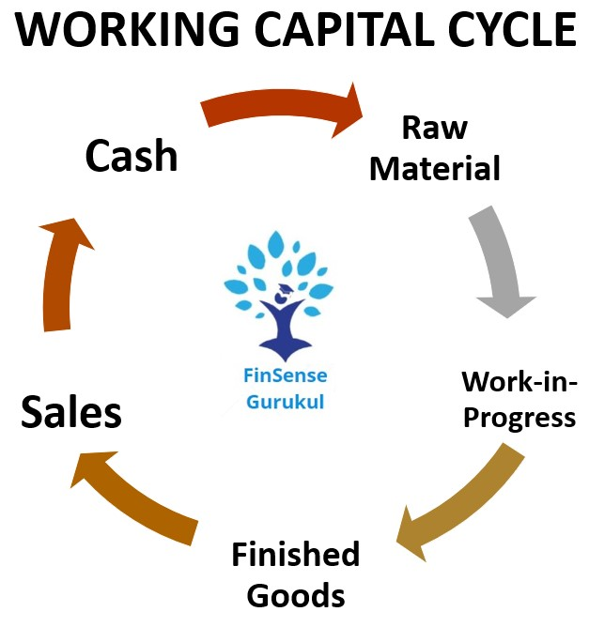
Operating Cycle of Working Capital
Source: FinSense Gurukul.com

Slide 20
Process of Working Capital Cycle
1. Conversion of cash into raw material.
Conversion of raw material into work in process/semi finished goods.
Conversion of work in process/semi finished goods into finished goods.
Conversion of finished goods into debtor/Bills receivable.
Conversion of debtor/Bills receivable into cash.

Slide 21
Summary
We have covered the following topics in this lecture:
Working Capital
Types of working capital
Importance of Working Capital
Operating Cycle of Working Capital

Slide 22
Session Learning Objectives
Students will be able to know the following concepts:
Approaches to determine financing of working capital.
Sources of Finance
Format of Profit & Loss Account
Cash flow
Objectives of cash flow statement
Format of cash flow statement

Slide 23
Approaches to determine financing of working capital
Approaches to determine financing of working capital.
There are mainly 3 approaches to determine financing of working capital. Let us discuss them one by one:

Slide 24
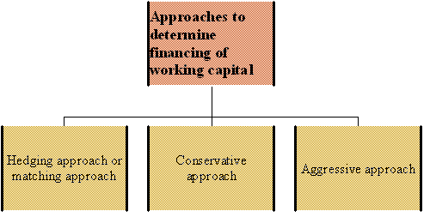
Approaches to determine financing of working capital

Slide 25
Approaches to determine financing of working capital
1) Hedging approach or matching approach: this approach means matching the maturities of debt with the maturity of financial needs. It means the sources of funds should match with the nature of assets to be financed. There are two types of working capital permanent and temporary working capital. The hedging approach suggests that the permanent working capital requirement should be financed through long term funds, while temporary working capital should be financed through the short term funds. There is low cost, high risk and high profit in this approach.
2) Conservative approach: as the name suggests it is a conservative approach which suggests that the entire requirement of current assets should be financed through long term sources and short term sources should be used only in case of emergency. There is high cost, low risk and low profit in this approach.

Slide 26
Approaches to determine financing of working capital
3) Aggressive approach: As the name suggests it is an aggressive approach which suggests that the entire requirement of current assets should be financed through short term sources. There is low cost, high risk and high profit in this approach.

Slide 27
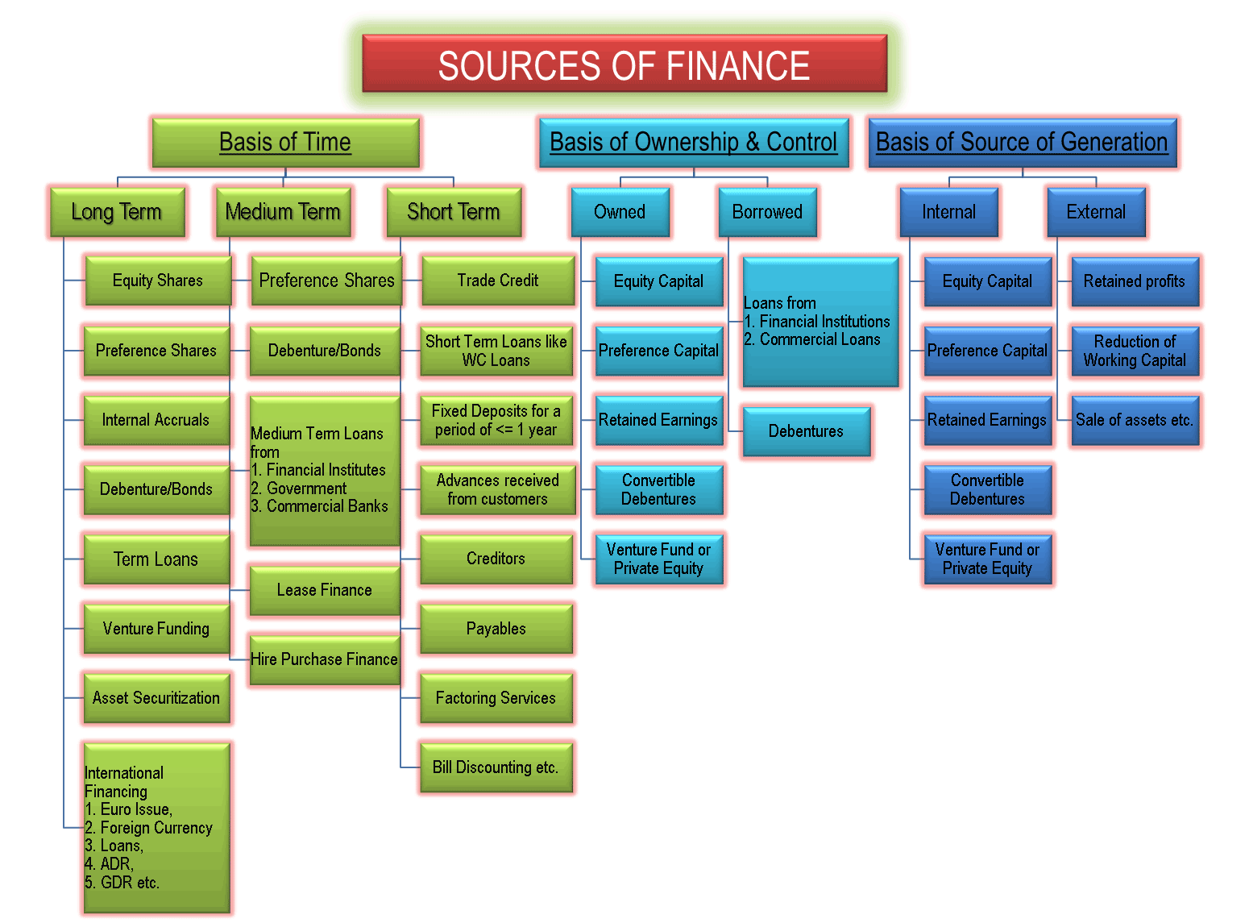
Sources of Finance

Slide 28
Stock
Stock
Stock includes finished products, parts, materials—whatever you sell to customers. The more stock—or products—you sell, the more revenue your business generates.
Inventory
Inventory includes finished products and all the assets a business owns or uses to complete production. There are Three main types of inventory.

Slide 29
Stock
Types of Inventory
There are three types of inventory
Raw Materials: The key ingredients required to make the finished good are known as raw materials.
Work In Progress: Products still being produced on the manufacturing floor are considered work-in-process inventory.
Finished Goods: Finished goods are items that have reached their full potential and are prepared for sale. The concept of inventory control is essential to corporate management. A business must ensure the right products are available at the right time.

Slide 30
Numerical
Characteristics of Inventories
Belong to current assets.
Kept in stock either to be sold to customers or to be consumed by. activities of the accounting entity.
Retailer, wholesaler.

Slide 31
Stock
Different methods for stock control management
Stock reviews.
Fixed-time/fixed-level reordering.
Just in time (JIT).
Economic Order Quantity (EOQ) .
First in, first out.
Batch control.
Vendor-managed inventory (VMI) .

Slide 32
Cash Management
Business organization desires to utilize available cash in most effective way
But management of cash is not as simple
It is challenging to decide how much cash is needed for day to day operation and how much cash should be put aside to meeting any emergency.

Slide 33
Objectives of Cash Management
Cash management is process to maintain sound cash position which maintains liquidity and use excess cash in profitable way.

Slide 34
Problem in Cash Management
Problem in cash management has been identified in these four areas:
Controlling Level of Cash
Controlling in-flow of cash
Controlling out-flow of cash
Optimal investment of excess cash

Slide 35
Summary
Cash is the most vital asset in any organization.
Cash is like blood in the body of a firm.
Cash should be managed with the clear understanding of various motives to hold it.
Firm should critically examine the factors affecting the cash needs.

Slide 36
Quiz
Define the Cash.
Discuss the importance of cash in any firm.
Why cash is needed to managed with great caution?
Explain the difference between profit and cash.
Discus the precautionary motive to hold the cash.
Explain why cash in hand and current account balances produce zero yield.
State the reason to hold the cash under transaction motive.
Describe the significance of liquidity in a firm.
Why firms hold the cash under speculative motive.
Explain the compensation motive to hold the cash.

Slide 37
Controlling Level of Cash
Some discrepancies in business organization's are predictable comes from discrepancy between in-flow and out-flow of cash
A. Predictable Discrepancies
B. Unpredictable discrepancy:
C. Source of Fund
D. Relationship with bank:

Slide 38
Controlling of In-flow of cash
Adequate control on cash in-flow is also problematic area It is concerned with speedy collection of cash and also with preventing fraudulent diversion of cash in-flow.
For speedy Collection
Lock- Box System: This system of collection of in-flow cash is very popular in USA. Company has opened deposit accounts in several banks in different geographical locations.
Collection through regional branch offices:

Slide 39
Controlling Out-flow of cash
All payments from regional branch office is transferred to head office and head office in turn pay the bills directly to the parties.

Slide 40
Optimal Investment of Excess cash
The proper investment of excess cash in company at short notice is also a problem area.
Finance manager use its prudence and discretion for investment of excess cash.

Slide 41
Cash Planning and Cash Control
Tools for cash Control:
A. Cash budget report:
B.Cash Flow statement
C. Ration Analysis:

Slide 42
Cash Management Model
A number of mathematical model have been to develop to determined the optimal cash balance.
Two of such model are as follow;
William J. Baumol's inventory model
M. H. Miller and Daniel Orr’s Stochastic model

Slide 43
William J. Baumol's Inventory model
Baumol ’s model of cash management-
Trades off between opportunity cost or carrying cost or holding cost & the transaction cost. As such firm attempts to minimize the sum of the holding cash & the cost of converting marketable securities in to cash.
Helps in determining a firm's optimum cash balance under certainty

Slide 44
William J. Baumol's Inventory model
Opportunity Cost
Total Cost
Transaction Cost
Optimum Cash Balance
(Baumol’s Model : Tradeoff Between Holding cost and transaction cost)

Slide 45
William J. Baumol's Inventory model
Assumptions
Cash needs of the firm is known with certainty
Cash Disbursement over a period of time is known with certainty
Opportunity cost of holding cash is known and remains constant
Transaction cost of converting securities into cash is known and remains constant.

Slide 46
William J. Baumol's Inventory model
Algebraic representation of William J. Baumol's Inventory model
C = √ 2A*F
√o
C = Optimum Balance
A = Annual Cash Distribution
F = Fixed Cost Per Transaction
O = Opportunity Cost Of Holding

Slide 47
M. H. Miller and Daniel Orr’s Stochastic Model
Overview
The Miller and Orr model of cash management is one of the various cash management models in operation. It is an important cash management model as well. It helps the present day companies to manage their cash while taking into consideration the fluctuations in daily cash flow.

Slide 48
M. H. Miller and Daniel Orr’s Stochastic Model
Description
As per the Miller and Orr model of cash management the companies let their cash balance move within two limits
Upper Control limit
Lower Control Limit

Slide 49
M. H. Miller and Daniel Orr’s Stochastic Model
Miller – Orr Cash Management Model
Cash
Upper Control Limit : Buy Security
Curve representing Cash Purchase Market Security Balance
h
Return Point
Z
Sale of market security
O
Lower Control Limit : Buy Security

Slide 50
M. H. Miller and Daniel Orr’s Stochastic Model
Explanation For the Diagram
Along with a return point when the cash balance touches the upper Control limit (h), the marketable security is purchased to the extend till it reaches normal cash balance (Z)
In the same manner when the cash balance touches lower limit (o), the firm Will Sell the Marketable security to the extent till it reaches normal cash Balance (Z)

Slide 51

M. H. Miller and Daniel Orr’s Stochastic Model
Computation of Miller – Orr Model of Cash
Management
1/3
Spread (Z)= (3/4 * Transaction cost *Variance of Cash Flow)
Interest Rate
Return Point = Lower limit + Spread (Z)
3
2
2
Variance of Cash Flow = (Standard Deviation) or ( )

Slide 52
Cash flow
Cash flow
Cash flow statement is a statement disclosing the flow of cash during a specific period.
OR
“ It indicates the movement of cash within a specified period.”

Slide 53
Objectives of cash flow statement
1. Analysis of cash position
2. Short – Term cash planning and management
3. Evaluation of liquidity
4. Analysis of cash flow from different activities
5. Comparison on operational performance
6. Helpful in formulating the policies
7. Helpful in making future cash flow
8. Useful to outsiders

Slide 54
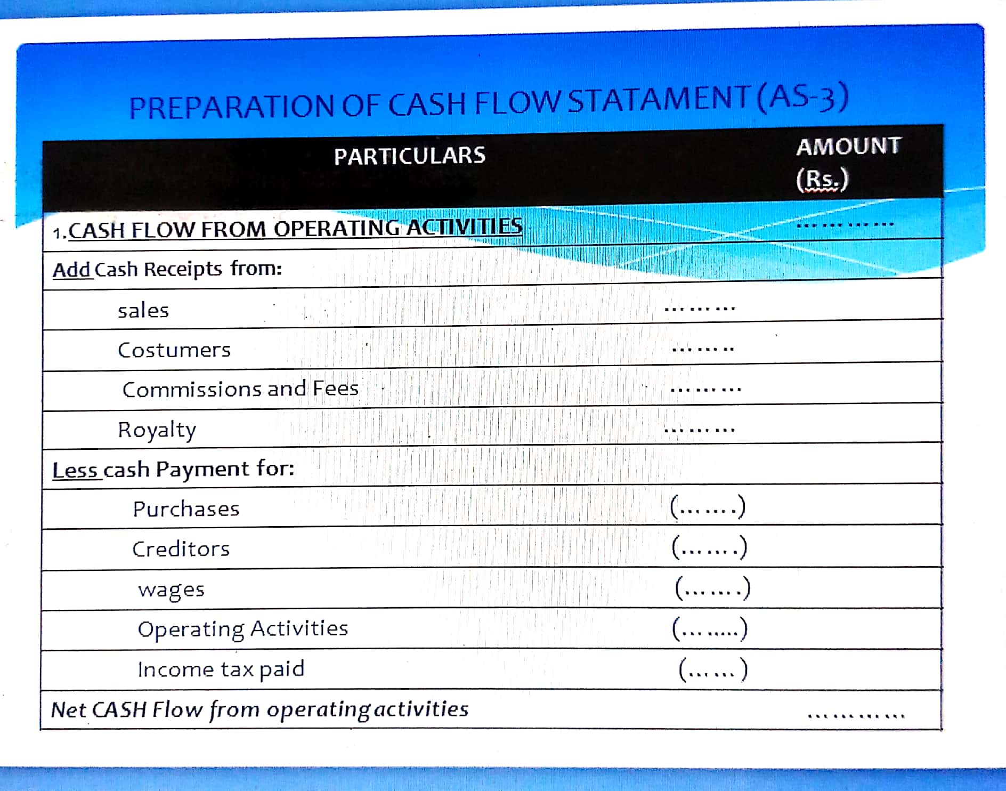
Format of Cash Flow (AS-3)

Slide 55
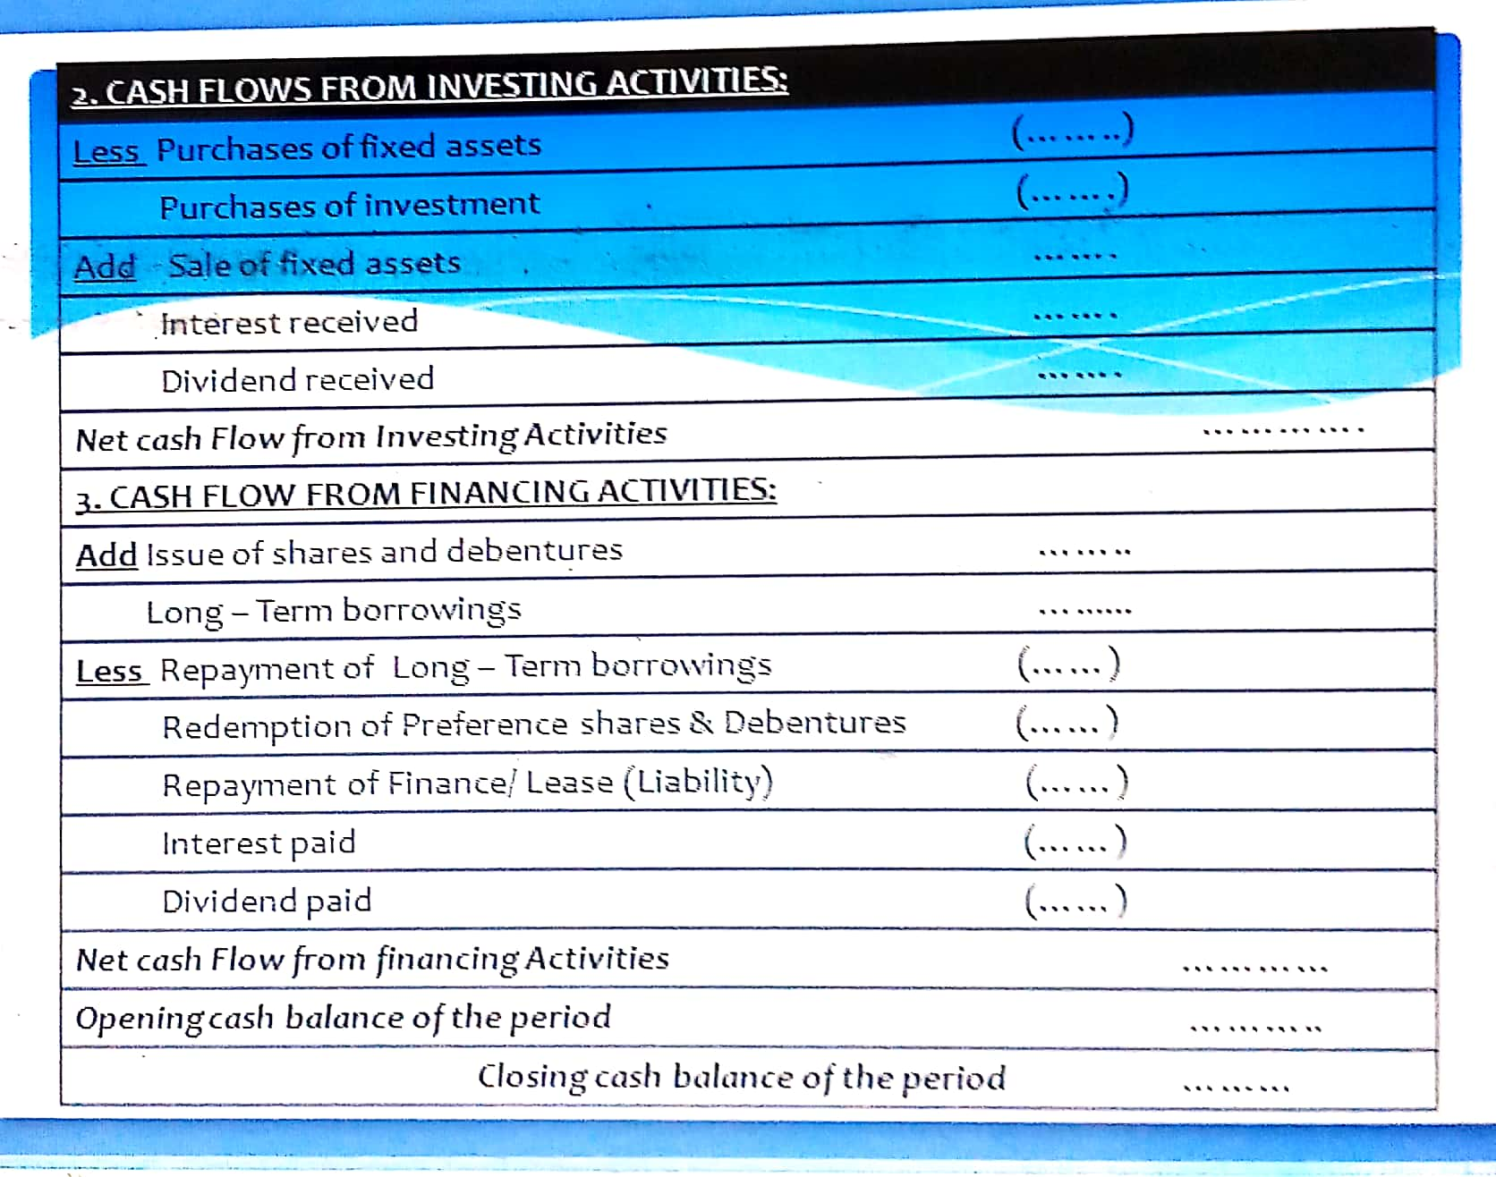
Format of Cash Flow (AS-3)
Source: www.theaccounting.org

Slide 56
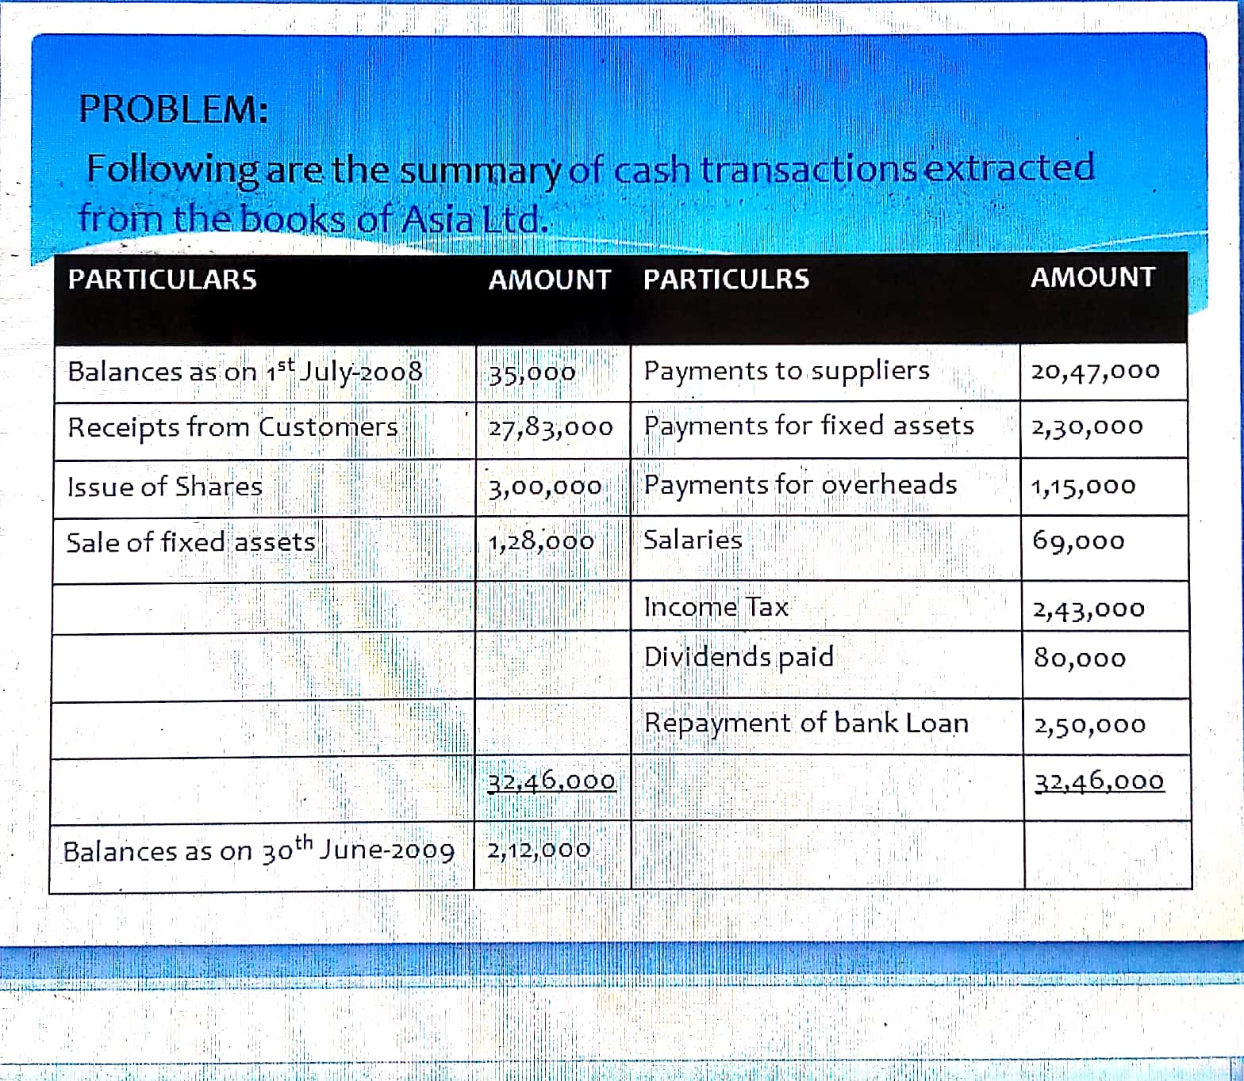
Numerical

Slide 57
Summary
We have covered the following topics in this lecture:
Approaches to determine financing of working capital.
Sources of Finance
Format of Profit & Loss Account
Cash flow
Objectives of cash flow statement
Format of cash flow statement

Slide 58
Prerequisite and Recap
Working Capital
Types of working capital
Importance of Working Capital
Operating Cycle of Working Capital

Slide 59
Session Learning Objectives
Students will be able to know the following concepts:
Prepare a cash flow statement (As per AS-3)
Numerical Problem
DuPont analysis
Funds Flow Statement
Importance of funds flow statement
Preparation of funds flow statement

Slide 60
Prepare a cash flow statement
Prepare a cash flow statement of the company for the period ended 30th June-2009 in accordance with AS-3 (Revised method) by Direct Method.

Slide 61
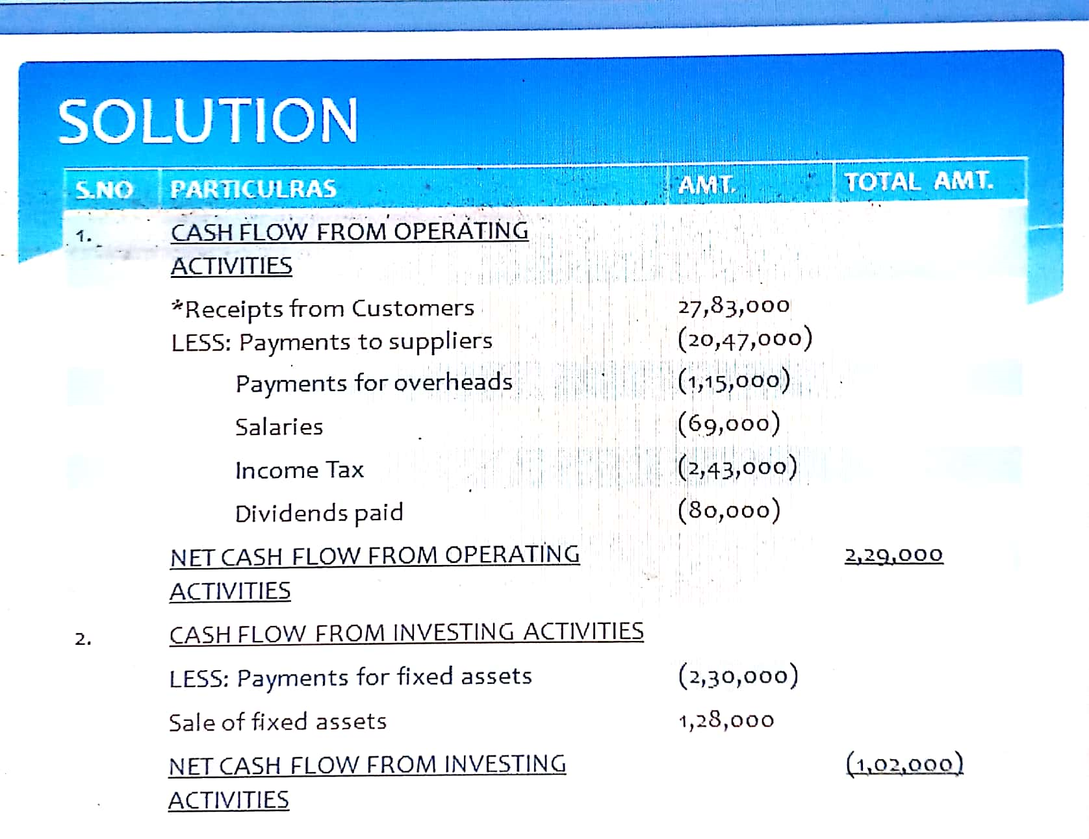
Solution

Slide 62
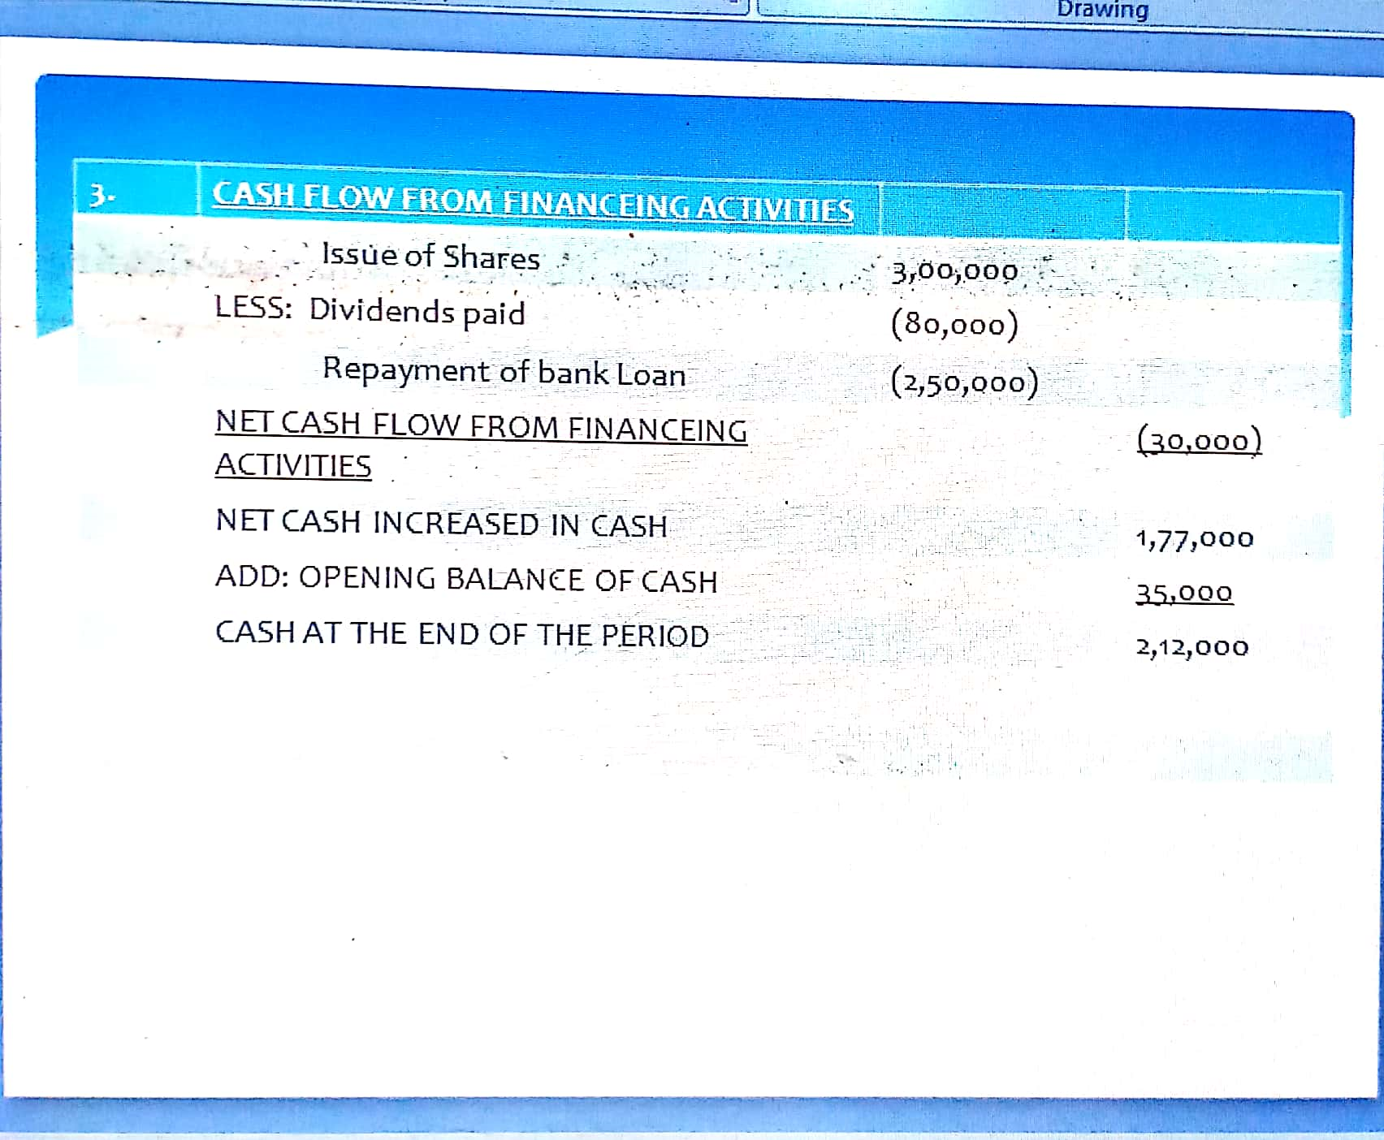
Solution

Slide 63
Quiz
Define the Upper control limit.
Discuss the Lower control limit.
Elaborate the holding cost for cash.
Explain the return point for better cash needs determination.
Explain the Miller-Orr concept of cash managment.
What are the distinct features of the Stone’s cash management model?
How optimum cash balance is determined using the Baumol’s model .
What is meant by transaction cost.
Discuss the inner and outer control limits.
How cash cycle is calculated using the cash cycle method?

Slide 64
Video Links
Youtube/other Video Links
https://youtu.be/zdTqlnSqO48
https://youtu.be/XXB08Xbbk1k
https://youtu.be/pISQMexnmew
https://youtu.be/YuyPL_pDuW4

Slide 65
Daily Quiz
1.What are the aspects of working capital management?
a. Inventory management
b. Receivable management
c. Cash management
d. All of the above
2._________ function includes a firm’s attempts to balance cash inflows and outflows.
a) Finance
b) Liquidity
c) Investment
d) Dividend

Slide 66
Daily Quiz
5. Statement of cash flows includes
A) Financing Activities
B) Operating Activities
C) Investing Activities
D) All of the Above
6. In cash flows, when a firm invests in fixed assets and short-term financial investments results in
A) Increased Equity
B) Increased Liabilities
C) Decreased Cash
D) Increased Cash
7. A firm that issues stocks and bonds to raise funds results in
A) Decreases Cash
B) Increases Cash
C) Increases Equity
D) Increases Liabilities

Slide 67
Weekly Assignment
Q.1 “Working capital is like oxygen for a company.” Prove this statement.
Q.2 How many types of working capital are there?
Q.3 Differentiate between cash flow statement and funds flow statement.
Q.4 Draw the diagram of sources of working capital for company.

Slide 68
MCQ s
1.What are the aspects of working capital management?
a. Inventory management
b. Receivable management
c. Cash management
d. All of the above
2._________ function includes a firm’s attempts to balance cash inflows and outflows.
a) Finance
b) Liquidity
c) Investment
d) Dividend

Slide 69
MCQ s
3.Firms which are capital intensive rely on _________.
a) Equity
b) Short term debt
c) Debt
d) Retained earnings
4. To financial analysts, "working capital" means the same thing as __________.
a. total assets b. fixed assets c. current assets d. current assets minus current liabilities.

Slide 70
MCQ s
5. Statement of cash flows includes
A) Financing Activities
B) Operating Activities
C) Investing Activities
D) All of the Above
6. In cash flows, when a firm invests in fixed assets and short-term financial investments results in
A) Increased Equity
B) Increased Liabilities
C) Decreased Cash
D) Increased Cash
7. A firm that issues stocks and bonds to raise funds results in
A) Decreases Cash
B) Increases Cash
C) Increases Equity
D) Increases Liabilities

Slide 71
MCQ s
8. The purchase value of assets over its serviceable life is categorized as
A) Appreciated Liabilities
B) Appreciated Assets
C) Depreciation
D) Appreciation
9. The statement of cash flow clarifies cash flows according to
A) Operating and Non-operating Flows
B) Inflow and Outflow
C) Investing and Non-operating Flows
D) Operating, Investing, and Financing Activities
10. Cash flow example from a financial activity is
A) Payment of Dividend
B) Receipt of Dividend on Investment
C) Cash Received from Customers
D) Purchase of Fixed Asset

Slide 72
Glossary Questions
Attempt all the parts: please pick the correct option from Glossary:
1. There exists a close association between sales fluctuations and invested amounts in .........................
2. Institute of Chartered Accountants of India suggests and follows the structure of a ......................... form of balance sheet.
3. Under the conventional method, ......................... enters into the calculation of working capital.
4. A company’s operating cycle naturally consists of three most important activities: ......................, ....................... and ....................
5. The ......................... shows the time period over which additional no impulsive sources of working capital financing must be obtained to carry out the firm’s actions.
Current assets , perpendicular , Cash ,Purchasing resources, producing the product, selling the product , Cash alteration cycle

Slide 73
Old Question Papers
MM:100
SECTION A
Attempt all questions in brief. 2 x 10 = 20
What is Financial Accounting?
Define Net Sales and Net Purchases.
Explain Goodwill and Copyright.
What is dividend?
Explain provisions.
What is a Comparative Balance Sheet?
Explain the term solvency of a firm.
What is Schedule of Changes in Working Capital?
Discuss the concept of cash.
What is depreciation?
Source: www.aktuonline.com

Slide 74
Old Question Papers
SECTION B
Attempt any three of the following: 10 x 3 = 30
Discuss various conventions of Accounting.
What are final accounts? Briefly discuss the uses and limitations of final accounts.
What do you understand by Analysis and Interpretation? Explain various tools of analysis of financial statements.
Explain in brief various statements that are prepared in fund flow Analysis. Show the format of each statement.
Differentiate between find flow and cash flow analysis which one is more beneficial for a firm.
Source: www.aktuonline.com

Slide 75
Old Question Papers
SECTION C
Attempt any one part of the following: 10 x 1 = 10
What is the importance of Accounting? Also discuss various types of accounting.
Discuss the role and objectives of International and Indian Accounting Standards.
Attempt any one part of the following: 10 x 1 = 10
What is Journalizing? Explain the concept of Ledger posting and balancing of accounts.
Discuss the adjustment entries. Give any five adjustment entries.
Source: www.aktuonline.com

Slide 76
Old Question Papers
What is Ratio Analysis? Explain various types of ratios and discuss which type of ratios is used in calculating profitability and liquidity of a firm.
Attempt any one part of the following: 10 x 1 = 10
What is a Balance Sheet? Briefly explain Marshalling of Balance sheet with example.
“Fund Flow analysis is an effective tool of managing working capital in a firm.” Explain.
Attempt any one part of the following: 10 x 1 = 10
Elaborate various types of activities that are considered in a Cash Flow Analysis.
What is inventory? Explain various types of inventory.
Source: www.aktuonline.com

Slide 77
Old Question Papers
Attempt any one part of the following: 10 x 1 = 10
State the final accounts. Briefly discuss the uses and limitations of final accounts.
Discuss the importance of Accounting? Also discuss various types of accounting.
Source: www.aktuonline.com

Slide 78
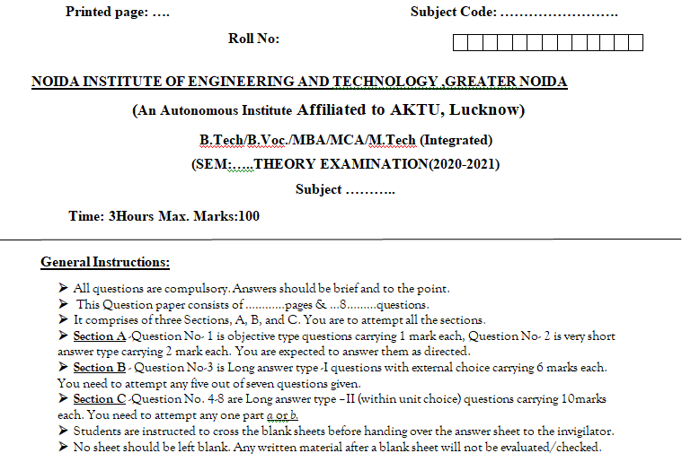
End Semester Question Paper Template

Slide 79
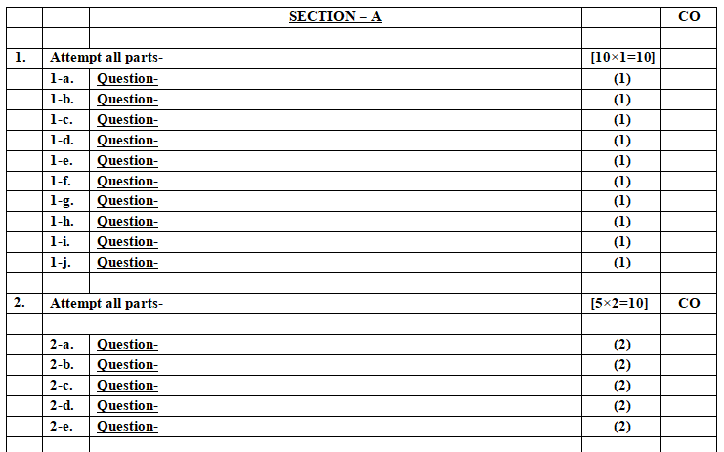
End Semester Question Paper Template

Slide 80
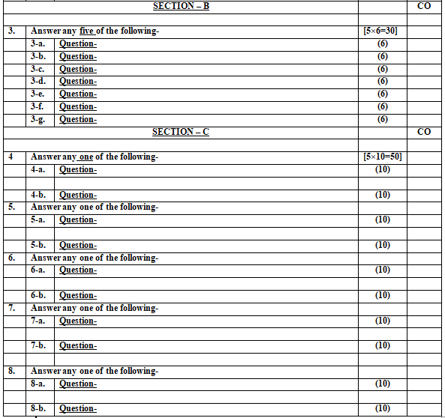
End Semester Question Paper Template

Slide 81
Expected Questions for University Exam
State the meaning of Funds flow statement
How is the schedule of changes in working capital prepared?
Discuss the importance of funds flow statement .
Explain the terms ‘funds items‘ and ‘non funds items. Give examples.
Write short notes on application of funds.
How are the funds from operations calculated?
Distinguish between the funds flow statement and Balance-Sheet.

Slide 82
Expected Questions for University Exam
Explain the terms ‘Funds’ and ‘Flow in funds ’ in respect of funds flow statement
Define Funds Flows statement. How is it prepared? What are the various sources and uses of funds ?
How is a funds flow statement prepared ?Give a Performa of schedule of changes in working capital and funds flow statement.
Explain in brief various statements that are prepared in fund flow Analysis. Show the format of each statement.
Differentiate between find flow and cash flow analysis which one is more beneficial for a firm.
Fund Flow analysis is an effective tool of managing working capital in a firm.” Explain.

Slide 83
Summary
Rules of preparing funds flow statement
Format of funds flow statement
Precautions to be taken while preparing funds flow statement
Numerical problem

Slide 84
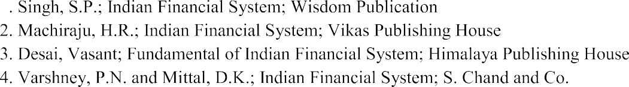

References
References:
Source: www.aktuonline.com

Slide 85
References
Thank You

